Slide 1
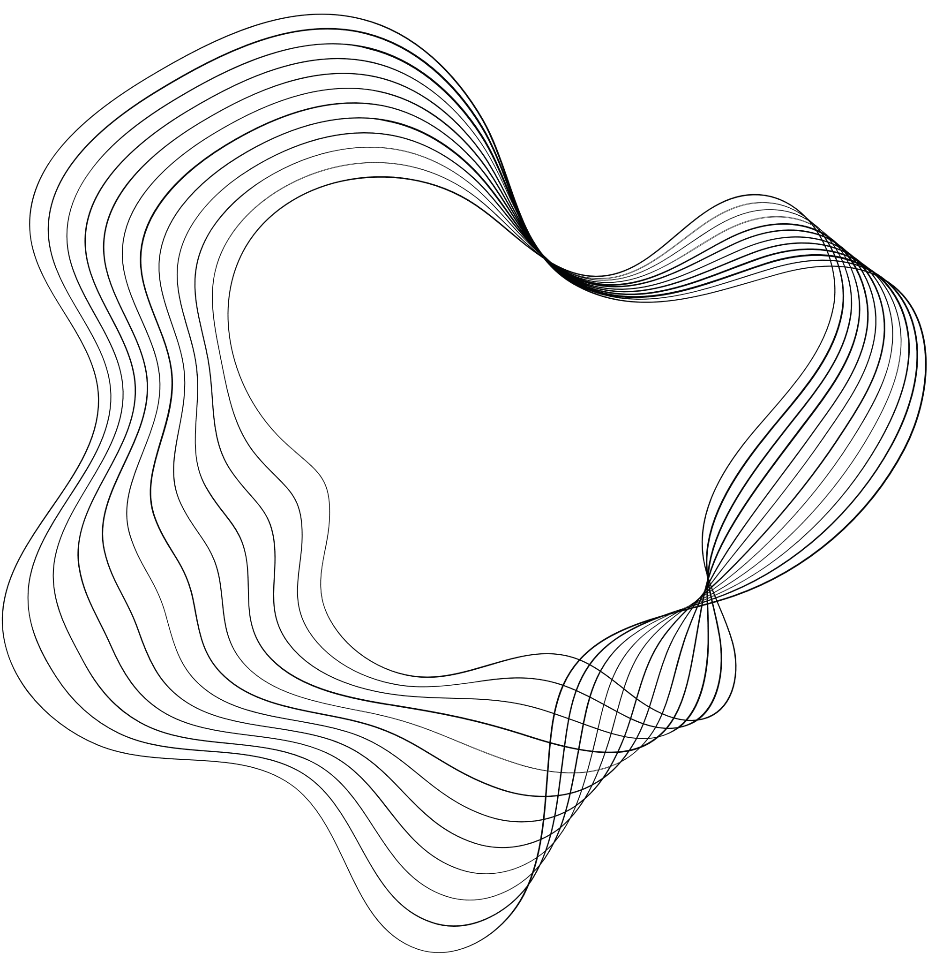

DATA ENGINEERING
PROJECT 2

Slide 2

CONTENT
01
GROUP INTRODUCTION
02
DATA BRIEF
03
WORKFLOWS
04
RESULT
05
CONCLUSION

Slide 3

OUR GROUP
Alain Merceron
Peter Szilvasi
Jo Kudo
Balint Thaler
Arbash Malik

Slide 4
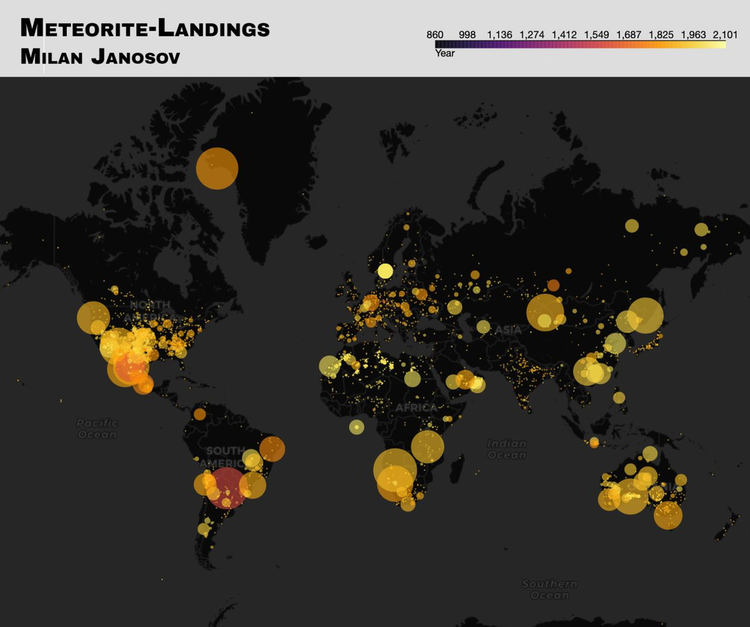




ANALYSIS DETAILS
Milan Janosov: Either meteorites target inhabited lands, or we have more data on meteorites where there are more people to find them, right?
QUESTION
HYPOTHESIS
Do meteors observations/landings really target areas with higher population density? OR meteor observations/landings are observed more frequently in countries which have a developed economy (dedicated budget for exploration)
To answer our question, the distribution should be skewed to either higher population density, or higher GDP per Capita
ANALYSIS
Check the distribution for meteor landings with population density and GDP per Capita

Slide 5

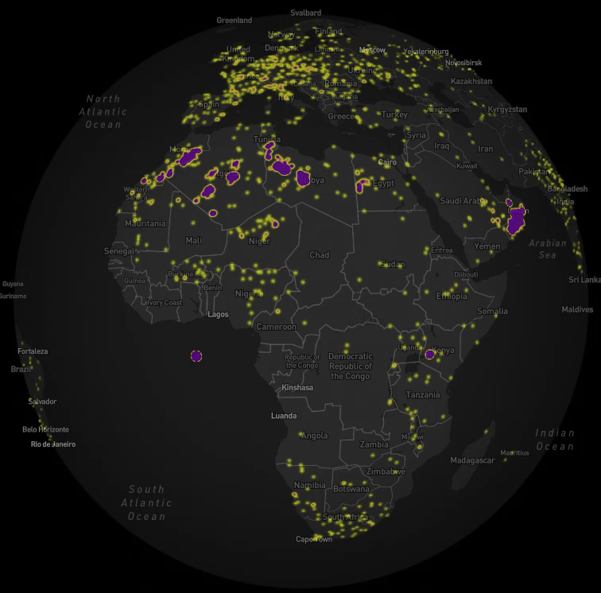
DEEP DIVE
WE PLOTTED THE HEATMAP OF THE METEORITE LANDINDS FOR US TO GIVE A GRAPHICAL LOOK AND HELP US UNDERSTAND THE DATA.
THIS WAS DONE PLOTTING THE DATASET IN MONGO DB AS JSON DATA AND THEN GEOJSON FOR MAPPING PURPOSES.
THE PURPLE COLOR INDICATES THAT LARGE NUMBERS OF METEORITE LANDINGS RECORDED IN THE AREA.
World Map Link

Slide 6





DATA BRIEF
We used a meteorite landings data set from NASA’s website
Total Observations = 45k+ (each observation is a meteorite landing)
Columns (details of meteor) include Name, ID, Class, Mass(g), Geo Location
We also used a World Bank dataset on GDP/Capita
Total Observations = 200+ (each observation is a country or a region)
Columns include Country Name, Country Code, Indicator, Years (1960 to 2022)
For the API, we used BigDataCloud API for geocoding.
To get the Country from the Geo Locations as well as country codes
To further enhance our data, we used the World Bank API
To get the population density for each country
Notes:
Describe data

Slide 7




ASSUMPTIONS & EXCLUSIONS
TO LIMIT OUR DATA TO RECENT OBSERVATIONS, WE FILTERED FOR OBSERVATIONS THAT ARE OBSERVED FROM 2000 AND ONWARDS
WE ALSO EXCLUDED ANTARCTICA FROM THE OBSERVATIONS SINCE IT HAS A DEDICATED PROGRAM FOR METEORITE EXPLORATION.
2007 WAS TAKEN AS THE BASE YEAR FOR ALL COUNTRIES FOR GDP PER CAPITA.
REGIONS ( SUB SAHARAN AFRICA, WORLD ETC.) WERE EXCLUDED FROM THE DATASET AS WELL.

Slide 8
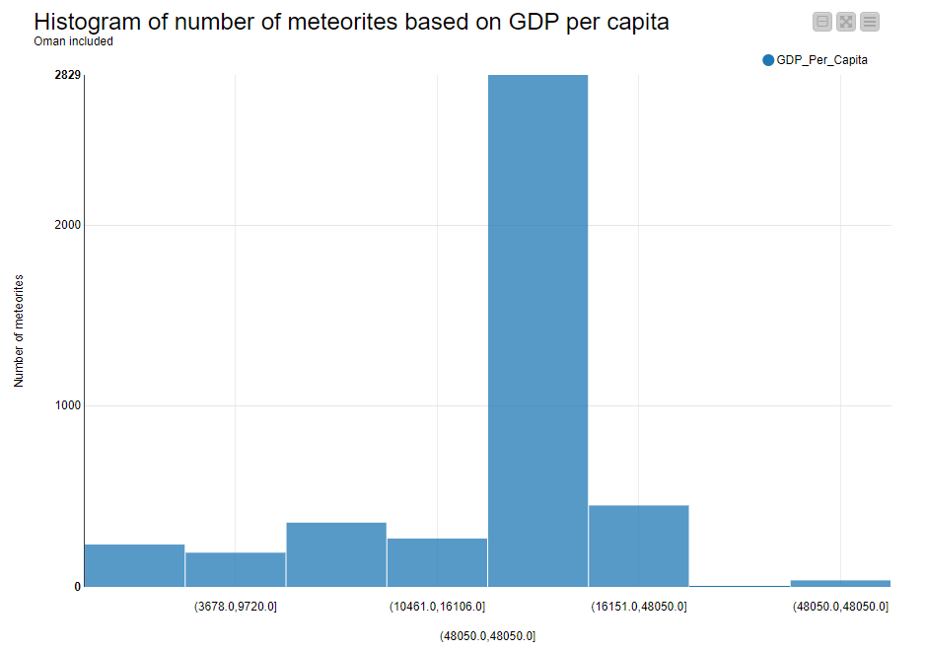
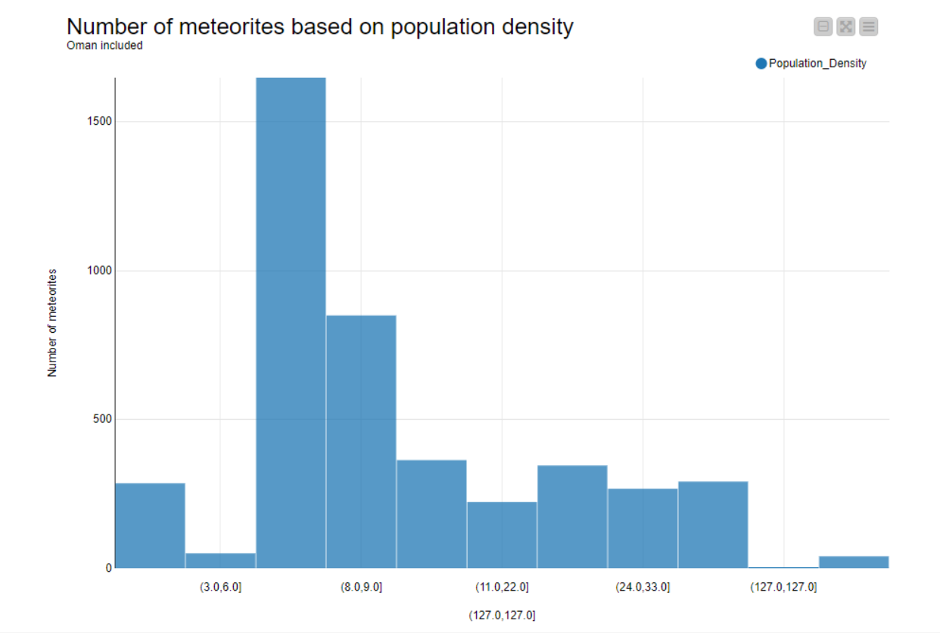
DISTRIBUTION COMPARISON
GDP PER CAPITA
OMAN INCLUDED
POPULATION DENSITY
OMAN INCLUDED
TOTAL OBSERVATIONS = 4.3K
OMAN OBSERVATIONS = 2.5K

Slide 9
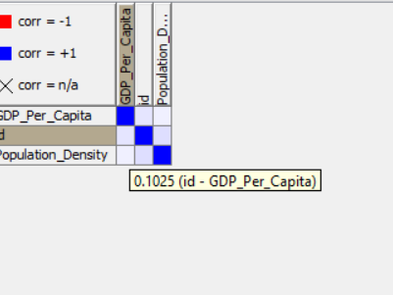
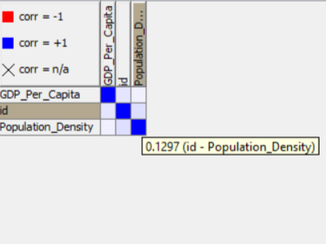
CORRELATIONS
GDP PER CAPITA
OMAN INCLUDED
POPULATION DENSITY
OMAN INCLUDED
TOTAL OBSERVATIONS = 4.3K
OMAN OBSERVATIONS = 2.5K

Slide 10
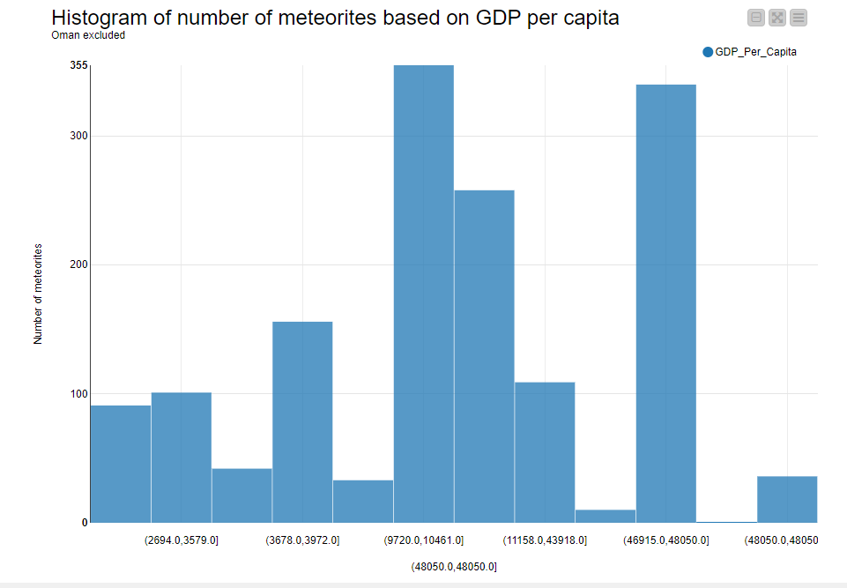
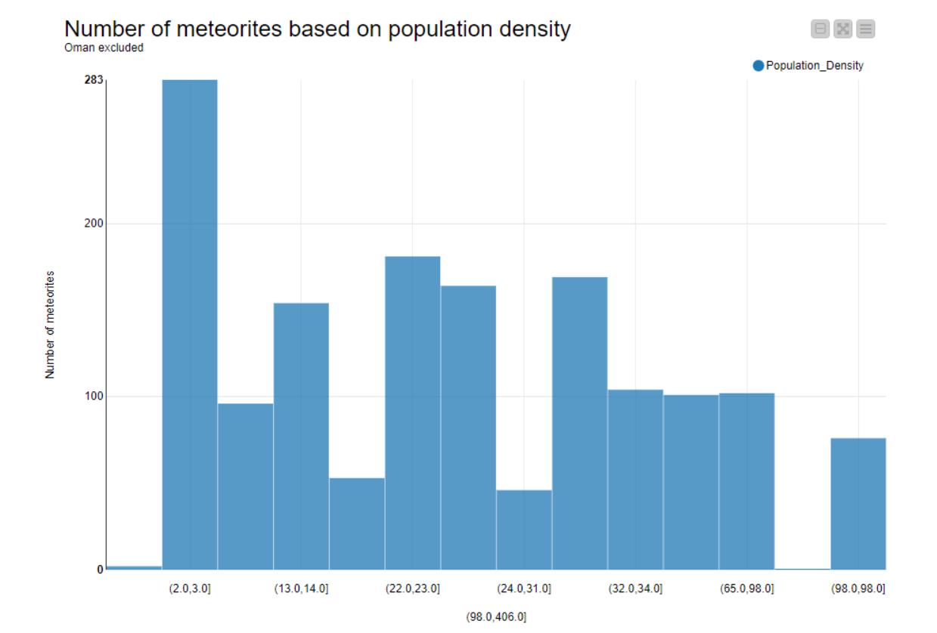
DISTRIBUTION COMPARISON
GDP PER CAPITA
OMAN EXCLUDED
POPULATION DENSITY
OMAN EXCLUDED
TOTAL OBSERVATIONS = 4.3K
OMAN OBSERVATIONS = 2.5K

Slide 11
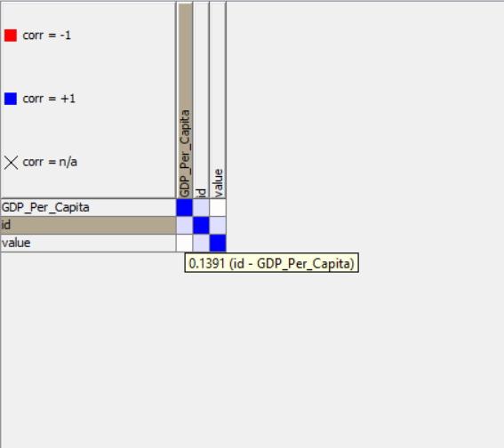
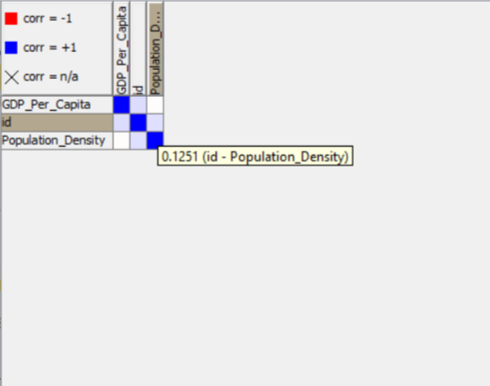
CORRELATIONS
GDP PER CAPITA
OMAN EXCLUDED
POPULATION DENSITY
OMAN EXCLUDED
TOTAL OBSERVATIONS = 4.3K
OMAN OBSERVATIONS = 2.5K

Slide 12
FINDINGS
EXCLUDING OMAN, WE CAN SEE THERE IS A POSITIVE CORRELATION BETWEEN THE NUMBER OF METEORITE OBSERVATIONS, GDP PER CAPITA, & POPULATION DENSITY.
THE METEORITE OBSERVATIONS ALSO TEND TO BE LINKED TO THE TOPOGRAPHY OF THE PLACE, FOR E.G HARSHER AREAS LIKE THE AMAZON FOREST REGION, OR SUB-ARCTIC REGIONS LIKE NORTHERN RUSSIA OR GREENLAND, OR MOUNTAINEOUS REGIONS LIKE THE HIMALAYAN RANGE HAVE LITTLE OR NO OBSERVATIONS AT ALL, SUGGESTING THAT IT IS HARDER FOR PEOPLE TO INVESTIGATE CLAIMS OF METEORITE LANDINGS. OPPOSEDLY DESERTS ARE FAVOURABLE PLACES BY NATURE.
Notes:
Describe data

Slide 13
THANK YOU FOR YOUR ATTENTION!
QUESTIONS?
Notes:
Describe data

Slide 14
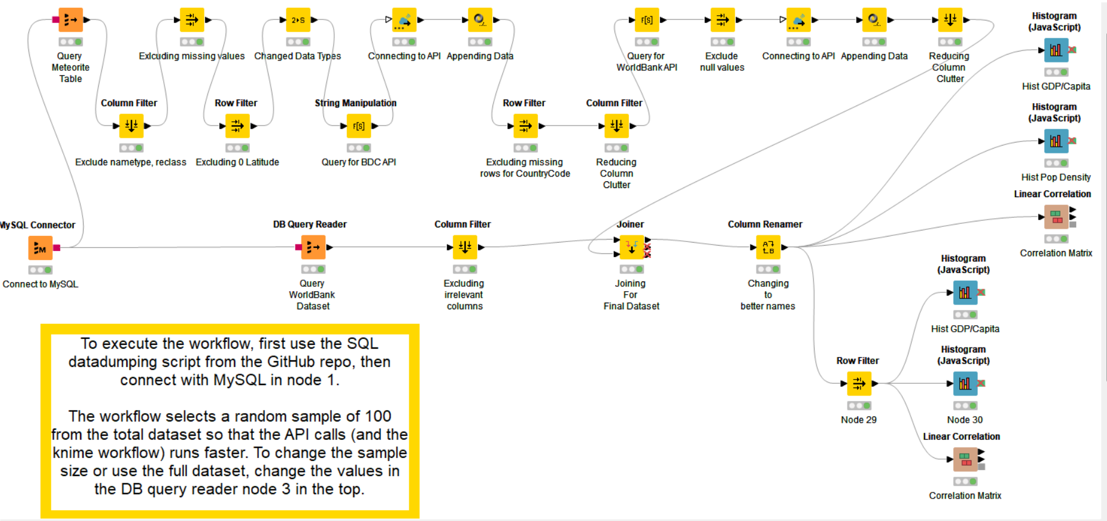
APPENDIX 1: KNIME WORKFLOW

